Slide 1
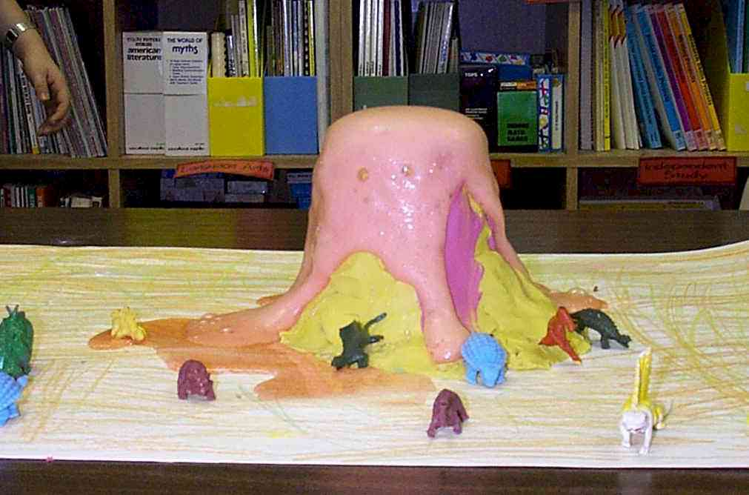

Chemical Reactions
SAVE PAPER AND INK!!! When you print out the notes on PowerPoint, print "Handouts" instead of "Slides" in the print setup. Also, turn off the backgrounds (Tools>Options>Print>UNcheck "Background Printing")!

Slide 2
Types of Reactions
There are five types of chemical reactions we will talk about:
  Synthesis reactions
  _____________ reactions
  Single displacement reactions
  ________________ reactions
  Combustion/Oxidation reactions
You need to be able to identify the type of reaction and predict the product(s)

Slide 3
Steps to Writing Reactions
Some steps for doing reactions
  Identify the type of reaction
  Predict the product(s) using the type of reaction as a model
  Balance it
  Don’t forget about the diatomic elements! (HOFBrINCl) For example, Oxygen is O₂ as an element.
  In a compound, it can’t be a diatomic element because it’s not an element anymore, it’s a compound!

Slide 4
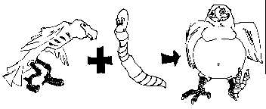
1. Synthesis reactions
Synthesis reactions occur when two substances (generally elements) combine and form a compound. (Sometimes these are called combination or addition reactions.)
reactant + reactant → 1 product
Basically: A + B → AB
  Example: 2H₂ + O₂ → 2H₂O
  Example: C + O₂ → CO₂

Slide 5
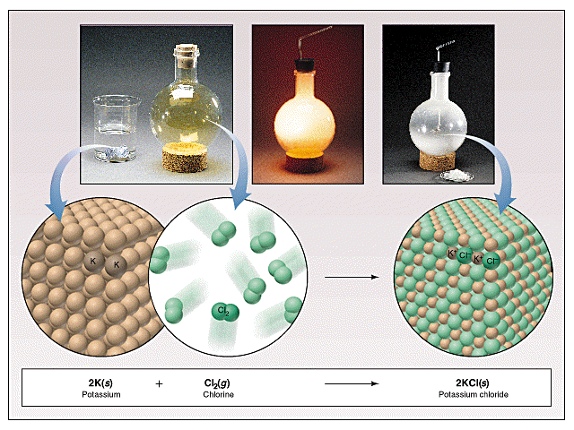
Synthesis Reactions
Here is another example of a synthesis reaction

Slide 6
Practice
Predict the products. Write and balance the following synthesis reaction equations.
Sodium metal reacts with chlorine gas
Na_{(s)} + Cl_{2(g)} →
Solid Magnesium reacts with fluorine gas
Mg_{(s)} + F_{2(g)} →
Aluminum metal reacts with fluorine gas
Al_{(s)} + F_{2(g)} →

Slide 7
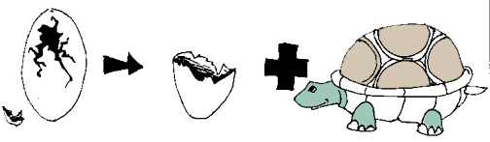
2. Decomposition Reactions
Decomposition reactions occur when a compound breaks up into the elements or in a few to simpler compounds
1 Reactant → Product + Product
In general: AB → A + B
Example: 2 H₂O → 2H₂ + O₂
Example: 2 HgO → 2Hg + O₂

Slide 8
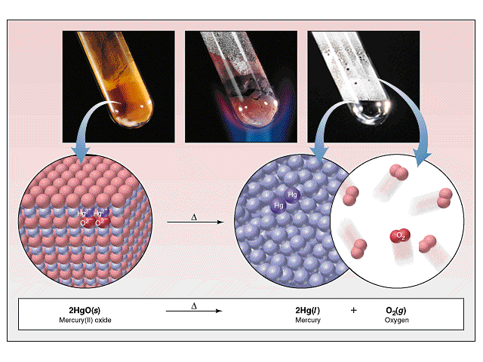
Decomposition Reactions
Another view of a decomposition reaction:

Slide 9
Decomposition Exceptions
Carbonates and chlorates are special case decomposition reactions that do not go to the elements.
  Carbonates (CO₃²⁻) decompose to carbon dioxide and a metal oxide
    Example: CaCO₃ → CO₂ + CaO
  Chlorates (ClO₃⁻) decompose to oxygen gas and a metal chloride
    Example: 2 Al(ClO₃)₃ → 2 AlCl₃ + 9 O₂
  There are other special cases, but we will not explore those in Chemistry I

Slide 10
Practice
Predict the products. Then, write and balance the following decomposition reaction equations:
Solid Lead (IV) oxide decomposes
PbO_{2(s)} →
Aluminum nitride decomposes
AlN_{(s)} →

Slide 11
Practice
Identify the type of reaction for each of the following synthesis or decomposition reactions, and write the balanced equation:
N_{2(g)} + O_{2(g)} →
BaCO_{3(s)} →
Co_{(s)}+ S_{(s)} →
NH_{3(g)} + H₂CO_{3(aq)} →
NI_{3(s)} →
Nitrogen monoxide
(make Co be +3)

Slide 12
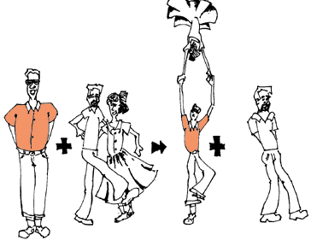
3. Single Displacement Reactions
Single Displacement Reactions occur when one element replaces another in a compound.
A metal can replace a metal (+) OR
a nonmetal can replace a nonmetal (-).
element + compound→ product + product
  A + BC → AC + B (if A is a metal) OR
  A + BC → BA + C (if A is a nonmetal)
(remember the cation always goes first!)
When H₂O splits into ions, it splits into
H⁺ and OH⁻ (not H+ and O⁻² !!)

Slide 13
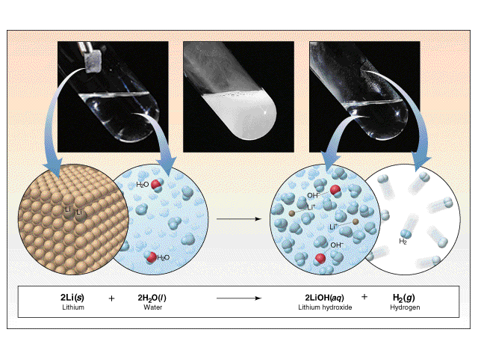
Single Displacement Reactions
Another view:

Slide 14
Single Displacement Reactions
Write and balance the following single displacement reaction equation:
Zinc metal reacts with aqueous hydrochloric acid
Zn_{(s)} + HCl_{(aq)} → ZnCl₂ + H_{2(g)}
Note: Zinc displaces the hydrogen ion in the reaction
2

Slide 15
Single Diplacement Reactions
Sodium chloride solid reacts with fluorine gas
NaCl_{(s)} + F_{2(g)} → NaF_{(s)} + Cl_{2(g)}
    Note that fluorine replaces chlorine in the compound
Aluminum metal reacts with aqueous copper (II) nitrate
Al_{(s)}+ Cu(NO₃)_{2(aq)}→
2
2

Slide 16
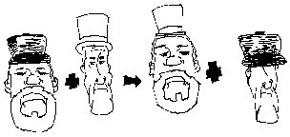
4. Double Displacement Reactions
Double Displacement Reactions occur when a metal replaces a metal in a compound and a nonmetal replaces a nonmetal in a compound
Compound + compound → product + product
AB + CD → AD + CB

Slide 17
Double Displacement Reactions
Think about it like “foil”ing in algebra, first and last ions go together + inside ions go together
Example:
AgNO_{3(aq)} + NaCl_{(s)} → AgCl_{(s)} + NaNO_{3(aq)}
Another example:
K₂SO_{4(aq)} + Ba(NO₃)_{2(aq)} → KNO_{3(aq)} + BaSO_{4(s)}
2

Slide 18
Practice
Predict the products. Balance the equation
HCl_{(aq)} + AgNO_{3(aq)} →
CaCl_{2(aq)} + Na₃PO_{4(aq)} →
Pb(NO₃)_{2(aq)} + BaCl_{2(aq)} →
FeCl_{3(aq)} + NaOH_{(aq)} →
H₂SO_{4(aq)} + NaOH_{(aq)} →
KOH_{(aq)} + CuSO_{4(aq)} →

Slide 19
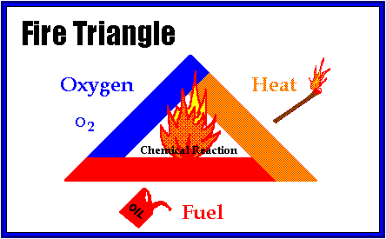
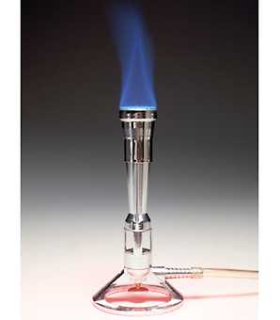
5. Combustion Reactions
Combustion reactions occur when a hydrocarbon reacts with oxygen gas.
This is also called burning!!! In order to burn something you need the 3 things in the “fire triangle”:
1) A Fuel (hydrocarbon)
2) Oxygen to burn it with
3) Something to ignite the reaction (spark)

Slide 20

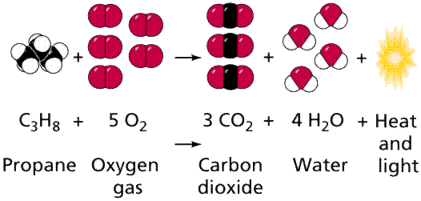
Oxidation Reaction
Similar to a synthesis reaction
Oxygen is one of the reactants
Products are oxides of each element

Slide 21


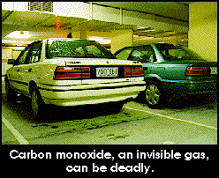
Combustion Reactions
In general:
C_{x}H_{y} + O₂ → CO₂ + H₂O
Products in combustion are ALWAYS carbon dioxide and water. (although incomplete burning does cause some by-products like carbon monoxide)
Combustion is used to heat homes and run automobiles (octane, as in gasoline, is C₈H₁₈)

Slide 22
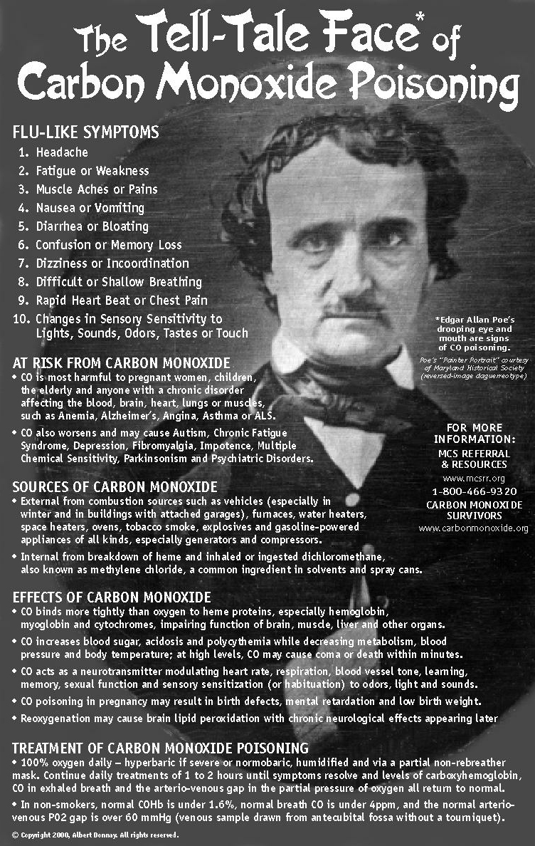
Combustion Reactions
Edgar Allen Poe’s drooping eyes and mouth are potential signs of CO poisoning.

Slide 23
Combustion
Example
  C₅H₁₂ + O₂ → CO₂ + H₂O
Write the products and balance the following combustion reaction:
  C₁₀H₂₂ + O₂ →
8
5
6

Slide 24
Mixed Practice
State the type, predict the products, and balance the following reactions:
BaCl₂ + H₂SO₄ →
C₆H₁₂ + O₂ →
Zn + CuSO₄ →
Cs + Br₂ →
FeCO₃ →

Slide 25
Double Displacement
Ionic Equations
Once you write the molecular equation (synthesis, decomposition, etc.), you should check for reactants and products that are soluble or insoluble.
We usually assume the reaction is in water
We can use a solubility table to tell us what compounds dissolve in water.
If the compound is soluble (does dissolve in water), then splits the compound into its component ions
If the compound is insoluble (does NOT dissolve in water), then it remains as a compound

Slide 26
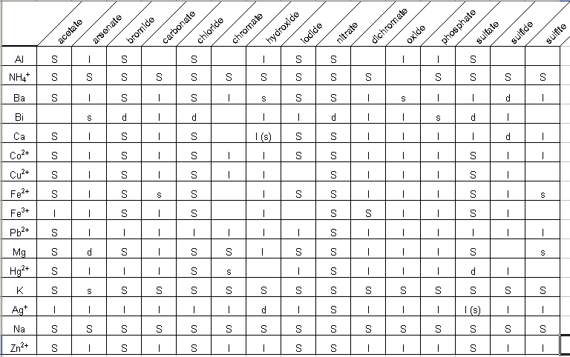
Solubility Table

Slide 27
Solubility Table page 137
Locate the anion in the first row
Locate the cation in the second and third rows
If in row two…
  the compound is soluble = aq
If in row three…
  the compound is not soluble = s
  a precipitate is formed

Slide 28
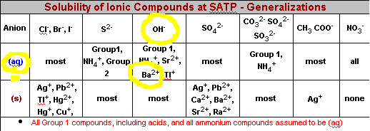
Solubility Table page 137

Slide 29
Solubilities Not on the Table!
Gases only slightly dissolve in water
Strong acids and bases dissolve in water
  Hydrochloric, Hydrobromic, Hydroiodic, Nitric, Sulfuric, Perchloric Acids
  Group I hydroxides (should be on your chart anyway)
Water slightly dissolves in water! (H+ and OH-)
For the homework… SrSO₄ is insoluble; BeI₂ and the products are soluble
There are other tables and rules that cover more compounds than your table!

Slide 30
Total Ionic Equations
Molecular Equation:
K₂CrO₄ + Pb(NO₃)₂ → PbCrO₄ + 2 KNO₃
Soluble Soluble Insoluble Soluble
Total Ionic Equation:
2 K⁺ + CrO₄ ⁻² + Pb⁺² + 2 NO₃⁻ →
PbCrO₄ (s) + 2 K⁺ + 2 NO₃⁻

Slide 31
Net Ionic Equations
These are the same as total ionic equations, but you should cancel out ions that appear on BOTH sides of the equation
Total Ionic Equation:
2 K⁺ + CrO₄ ⁻² + Pb⁺² + 2 NO₃⁻ →
PbCrO₄ (s) + 2 K⁺ + 2 NO₃⁻
Net Ionic Equation:
CrO₄ ⁻² + Pb⁺² → PbCrO₄ (s)

Slide 32
Net Ionic Equations
Try this one! Write the molecular, total ionic, and net ionic equations for this reaction: Silver nitrate reacts with Lead (II) Chloride in hot water.
  Molecular:
  Total Ionic:
  Net Ionic:

